Slide 1
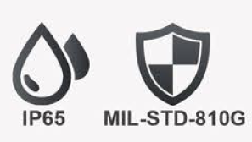
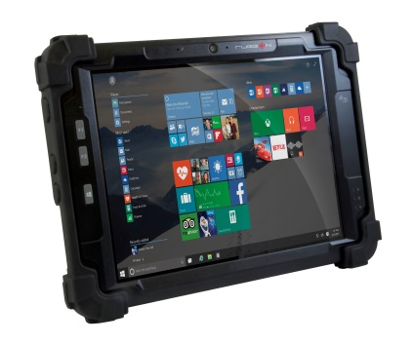
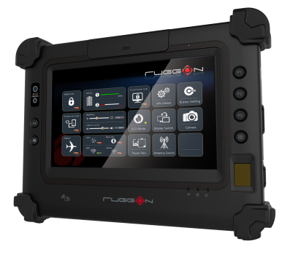
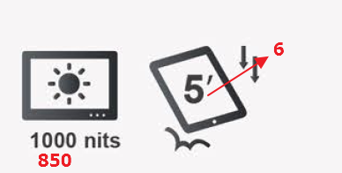
封面
檔名 : PM522_2.png
檔名 : PA-301_1.png

Slide 2
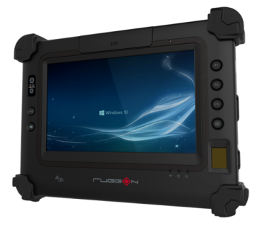
Page 2
Newly Enhanced 7-inch Rugged Tablet
Best-in-class Visibility
PM-311B, incorporated with 850 nits class-leading sunlight readable optical bonding technology to ensure optimized readability under direct sunlight for mobile workers.
檔名 : police_1.jpg
檔名 : police_2.jpg

Slide 3
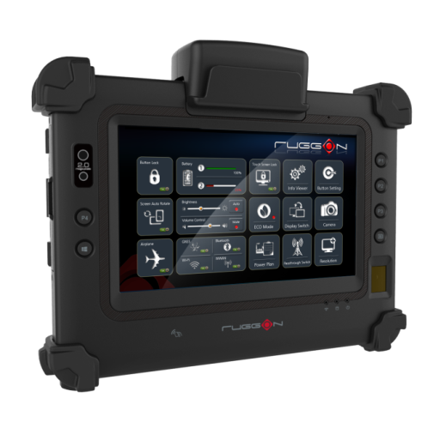
Designed to Secure
PM-311B, the world's first ever tablet that can read Up to 3 lines of machine-readable zone (MRZ) data – enabling it to capture, identify, and process passport, visa and ID card information right at your fingertip.
Tailored for public safety needs. PM-311B is also integrated with a 508-dpi capacitive and high-performance fingerprint reader to collect more detailed and accurate fingerprint characteristics and match them to database.
The first tablet with MRZ
P<USATRAVELER<<ANGELA<<<<<<<<<<<<<<<<<<<<<<<<
4577779991USA60000000M0811150<<<<<<<<<<<<<<08
加MRZ code作背景, 加個指紋

Slide 4
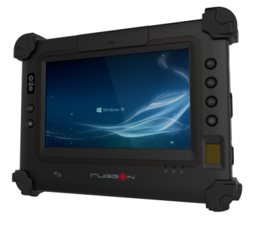
Enhanced Security Perimeters
Beside the encrypted SSD with FIPS 140-2 certification, we also offer a customized one button push function to quickly erase SSD data during emergencies by leveraging Phoenix's SecureWipe technology and implementing a number of global standard algorithms.
PM-311B is also equipped with Janus USB Ignition Key, which is the only security solution in the market that combines BIOS, Cloud services and physical USB Key all working together to authenticate users.
網路找的參考概念
https://www.google.com.tw/search?hl=zh-TW&site=imghp&tbm=isch&source=hp&biw=1419&bih=702&q=computer%2C+security&oq=computer%2C+security&gs_l=img.3..0i19l10.62274.68303.0.68829.23.21.2.0.0.0.98.1485.21.21.0....0...1ac.1.64.img..0.23.1503.9LqaBVv3P4Y
產品上加鎖或鑰匙或盾牌, 來抵擋惡意攻擊, 顯示我對於產品提供加強的防護網
Exceptional Versatility
Equipped with all the connectivity options and data capturing capabilities you need in one compact form factor, PM-311B empowers you to do more.
8MP Camera
Near Field Communication
2D Barcode Reader
Magnetic Stripe Reader

Slide 5
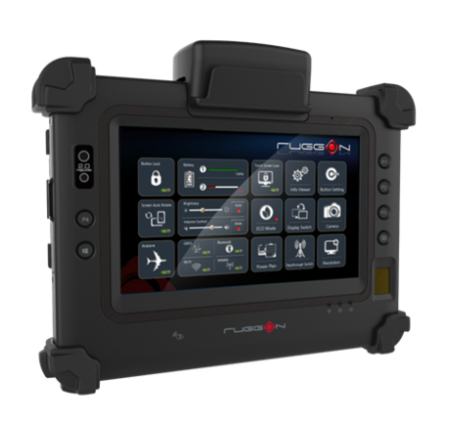
Application Highlight – Law Enforcement
Fingerprint Reader/NFC - ID authentication or checkpoint check-in
GNSS - Patrol route management & movement tracking record
Real time communications - Real time dispatch communications and police intelligence
FIPS-certified SSD, Janus USB Ignition Key and Phoenix SecureWipe – Protect vital database and device
MRZ Reader – Passport and travel documents control
Fingerprint Reader/Cameras - Collect fingerprint and photograph
Real time communication - Real time police intelligence
FIPS-certified SSD, Janus USB Ignition Key and Phoenix SecureWipe – Protect vital database and device
Police Daily Tasks
檔名 : task.jpg
檔名: PM311B_1.png
Border Control
Fingerprint Reader/NFC - ID authentication or checkpoint check-in
Fingerprint/MSR/MRZ Reader - Identify suspect of criminal acts
Electrical data capture - Speed up performance and documentation tasks
Real time communications - Real time dispatch communications and police intelligence
FIPS-certified SSD, Janus USB Ignition Key and Phoenix SecureWipe – Protect vital database and device
檔名 : border_1.jpg
檔名 : border_2.jpg
Road Block
檔名 : road_1.jpg
檔名 : road_2.jpg

Slide 6
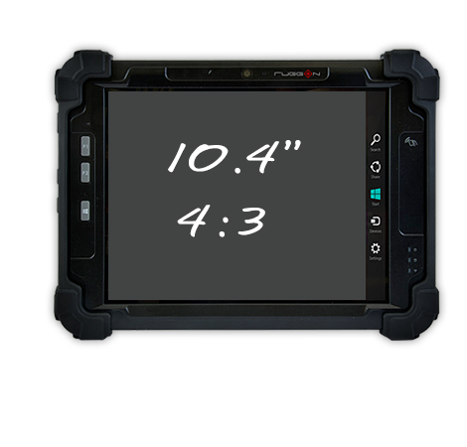
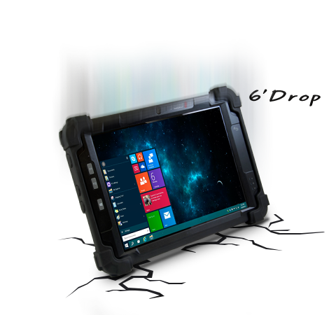
Page 3
Functionality and Durability. A Powerful Combination.
4:3 Screen with Class-leading Specification
The 4:3 screen of PM-522 is equipped to the highest specification on the market and offers large viewing area. It is easily compatible with existing software.
檔名 : PM522_1.png
Impressively Rugged Grade
As a best device for mobile workers, durability is key factor to fulfill each critical task. PM-522 meets rigorous IP65, 6 feet drop and MIL-STD-810G for vibration and shock resistance.
檔名 : Pm522.png

Slide 7
Field Dedicated Device
PM-522 comes with a number of functions for data capture to offer more simple and efficient device for field workers.
Near Field Communication
檔名 : Smart-Cards.png
2D Barcode Reader
Magnetic Stripe Reader

Slide 8
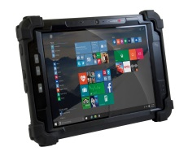
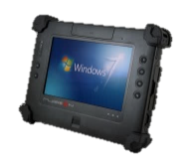
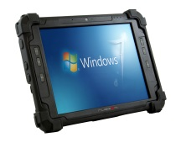
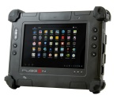
Page 4
PM-311B
PM-522
檔名 : PM522_2.png
Xxxx
Xxxxx
Xxxxx
Xxxx
xxxxx
Xxxxxxxxxxxxxxxx
Xxxxxxxxxxxxxx
Xxxxxxxxxxxxxxxxxx
Xxxxxxxxxxxxxx
xxxxxxxxxxxxxxxxx
Xxxx
Xxxxx
Xxxxx
Xxxx
xxxxx
Xxxxxxxxxxxxxxxx
Xxxxxxxxxxxxxx
Xxxxxxxxxxxxxxxxxx
Xxxxxxxxxxxxxx
xxxxxxxxxxxxxxxxx
PM-311
PM-511
檔名 : PM-511_2.jpg
Xxxx
Xxxxx
Xxxxx
Xxxx
xxxxx
檔名 : PM-311_4.jpg
Xxxx
Xxxxx
Xxxxx
Xxxx
xxxxx
Xxxxxxxxxxxxxxxx
Xxxxxxxxxxxxxx
Xxxxxxxxxxxxxxxxxx
Xxxxxxxxxxxxxx
xxxxxxxxxxxxxxxxx
Xxxxxxxxxxxxxxxx
Xxxxxxxxxxxxxx
Xxxxxxxxxxxxxxxxxx
Xxxxxxxxxxxxxx
xxxxxxxxxxxxxxxxx
PA-301
檔名 : PA-301_1.png
DashON App
(available for PM-311B, PM-522)
Xxxx
Xxxxx
Xxxxx
Xxxx
xxxxx
Xxxxxxxxxxxxxxxx
Xxxxxxxxxxxxxx
Xxxxxxxxxxxxxxxxxx
Xxxxxxxxxxxxxx
xxxxxxxxxxxxxxxxx
Besides core tablet settings, DashON APP features ECO mode for power saving functionality, Touch Screen Lock for preventing unintended touch, Button Setting for programmable function buttons, and Passthrough Switch for selecting the dual RF-antenna connections. CamON can check GPS positioning status and stamp geographical information on photos so users can track easily.

Slide 9
Page 4
PM-311B
PM-311
System
- Intel® ATOM N2600 1.6GHz
- 2GB DDR3 memory
- 32GB half-slim SATA SSD (up to 128GB)
- Optional OS : Windows Embedded Standard 7 Windows 7 Professional
System
- Intel ® Celeron® N2930, 1.83GHz
- DDR3L 4GB RAM memory, optional 8GB
- 128GB/256GB, optional 128GB FIPS 140-2 Level II SSD
Optional OS : Windows 10 IoT Enterprise for Small Tablet
Window Embedded 8.1 Industry Pro for Tablet
Display
7-inch WXGA (1280 x 800)
350 nits, optional 700 nits
- 5-wire resistive touch
Display
7-inch WSVGA (1024 x 600)
850 nits, optical bonding with AR/AF solution
- Multiple capacitive touch
Durability
MIL-STD-810G, 5 feet drop, IP65
Operating temp : -20ºC to +50ºC
Durability
MIL-STD-810G, 5 feet drop, IP65
Operating temp : -20ºC to +50ºC
Communication
- Wi-Fi 802.11 a/b/g/n
- GNSS (GPS, GLONASS)
- Bluetooth V4.0 + EDR
- Optional 4G LTE
Communication
- NFC
- Wi-Fi 802.11 a/b/g/n/ac
- GNSS (GPS, GLONASS, optional BeiDou)
- Bluetooth V4.0 + EDR
- Optional 4G LTE
Camera
Front 2MP, rear 5MP AF with LED flash
Camera
Front 2MP, rear 8MP AF with LED flash
I/O Interface
Ethernet (RJ45), RS232, USB 2.0, Micro USB, Micro SD slot, Micro SIM slot, audio jack, microphone, speaker, 32-pin docking connector
I/O Interface
Ethernet (RJ45), RS232, 2 x USB 3.0, Micro SD slot, Micro SIM slot, audio jack, speaker, microphone, 32-pin docking connector
Expansion
Optional 2D barcode reader + MSR 2-in-1 module
Expansion
- Optional MRZ reader+ MSR 2-in-1 module
- Optional 2D barcode reader + MSR 2-in-1 module
Battery
Long battery life support with hot-swappable battery
Security
TPM 2.0
- Optional fingerprint reader (capacitive type, 508 dpi)
- Optional Janus USB Ignition Key, Phoenix SecureWipe
Dimensions & Weight
22.5 x 16.8 x 2.7 cm (8.9” x 6.6” x 1”)
2.09 lbs (0.95kg)
Battery
Long battery life support with hot-swappable battery
Dimensions & Weight
22.5 x 16.8 x 2.7 cm (8.9” x 6.6” x 1”)
2.09 lbs (0.95kg)

Slide 10
Page 4
PA-301
PM-522
System
- Intel® Atom E3827 1.75GHz
- 4GB DDR3L memory
- 64GB mSATA SSD (optional 128GB/256GB)
- Optional OS : Windows 10 IoT Enterprise 2015 LTSB for Tablets
Windows Embedded 8.1 Industry
Windows Embedded Standard 8
Windows 7 Professional
Windows Embedded Standard 7
System
- TI Dual Core Cortex A9 OMAP4470 1.5GHz
- 2GB LPDDR2 memory
- 32GB eMMC (up to 64GB)
Optional OS : Android 4.0
Display
7-inch WXGA (1280 x 800)
350 nits, optional 700 nits
Multiple capacitive touch
Durability
MIL-STD-810G, 5 feet drop, IP65
Operating temp : -20ºC to +50ºC
Display
10.4-inch XGA (1024 x 768)
350 nits, optional 700 nits
- Multiple capacitive touch
Communication
- NFC
- Wi-Fi 802.11 a/b/g/n
- GPS
- Bluetooth V4.0 + EDR
- Optional 3.5G
Durability
- MIL-STD-810G, 6 feet drop, IP65
- Operating temp : : -20ºC to +50ºC
Communication
- NFC
- Wi-Fi 802.11 a/b/g/n/ac
- GNSS (GPS, GLONASS, optional BeiDou)
- Bluetooth V4.0 + EDR
- Optional 4G LTE
Camera
Front 1.2MP, rear 5MP AF with LED flash
I/O Interface
Ethernet (RJ45), RS232, USB 2.0, Micro USB, Micro SD slot, Micro SIM slot, audio jack, microphone, speaker, 32-pin docking connector
Camera
Front 2MP, rear 5MP AF with LED flash
Expansion
- Optional 2D barcode reader + MSR 2-in-1 module
I/O Interface
Ethernet (via Mini USB to RJ-45 adapter), USB 3.0, USB 2.0, Micro SIM slot, audio jack, speaker, microphone, 32-pin docking connector
Battery
Long battery life support with hot-swappable battery
Dimensions & Weight
22.5 x 16.8 x 2.7cm (8.9” x 6.6” x 1” )
2.09 lbs (0.95kg)
Security
TPM 1.2
Expansion
- Optional MSR
- Optional 2D barcode reader
- Optional smart card reader (CAC) + GNSS 2-in-1 module
Battery
Long battery life support with hot-swappable battery
Dimensions & Weight
27.5 x 20.4 x 2.7 cm (10.8” x 8” x 1.1”)
1.3kg (2.87 lbs)

Slide 11
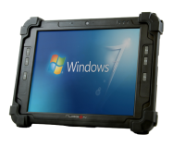
Page 4
PM-511
System
- Intel® Atom N2600 1.6GHz
- 2GB DDR3 memory
- 32GB half-slim SATA SSD (optional 64GB/128GB)
- Optional OS : Windows Embedded Standard 7
Windows 7 Professional
Display
10.4-inch XGA (1024 x 768); 350 nits, optional 700 nits
- 5-wire resist ive touch
Durability
MIL-STD-810G, 6 feet drop, IP65
Operating temp : -20ºC to +50ºC
Communication
- Wi-Fi 802.11 a/b/g/n
- Bluetooth V4.0 + EDR
- Optional 3.5G
Camera
Front 2MP, rear 5MP AF with LED flash
I/O Interface
Ethernet (via Mini USB to RJ-45 adapter), 2 x USB 2.0, Micro SIM slot, audio jack, speaker, microphone, 32-pin docking connector
Expansion
- Optional GNSS (GPS, GLONASS)
- Optional NFC + GNSS 2-in-1 module
- Optional MSR
- Optional 2D barcode reader
- Optional smart card reader (CAC) + GNSS 2-in-1 module
- Optional 2D barcode reader + GNSS 2-in-1 module
Battery
Long battery life support with hot-swappable battery
Dimensions & Weight
27.5 x 20.4 x 2.7 cm (10.8” x 8” x 1.1”)
1.4kg (3.09 lbs)

